Slide 1
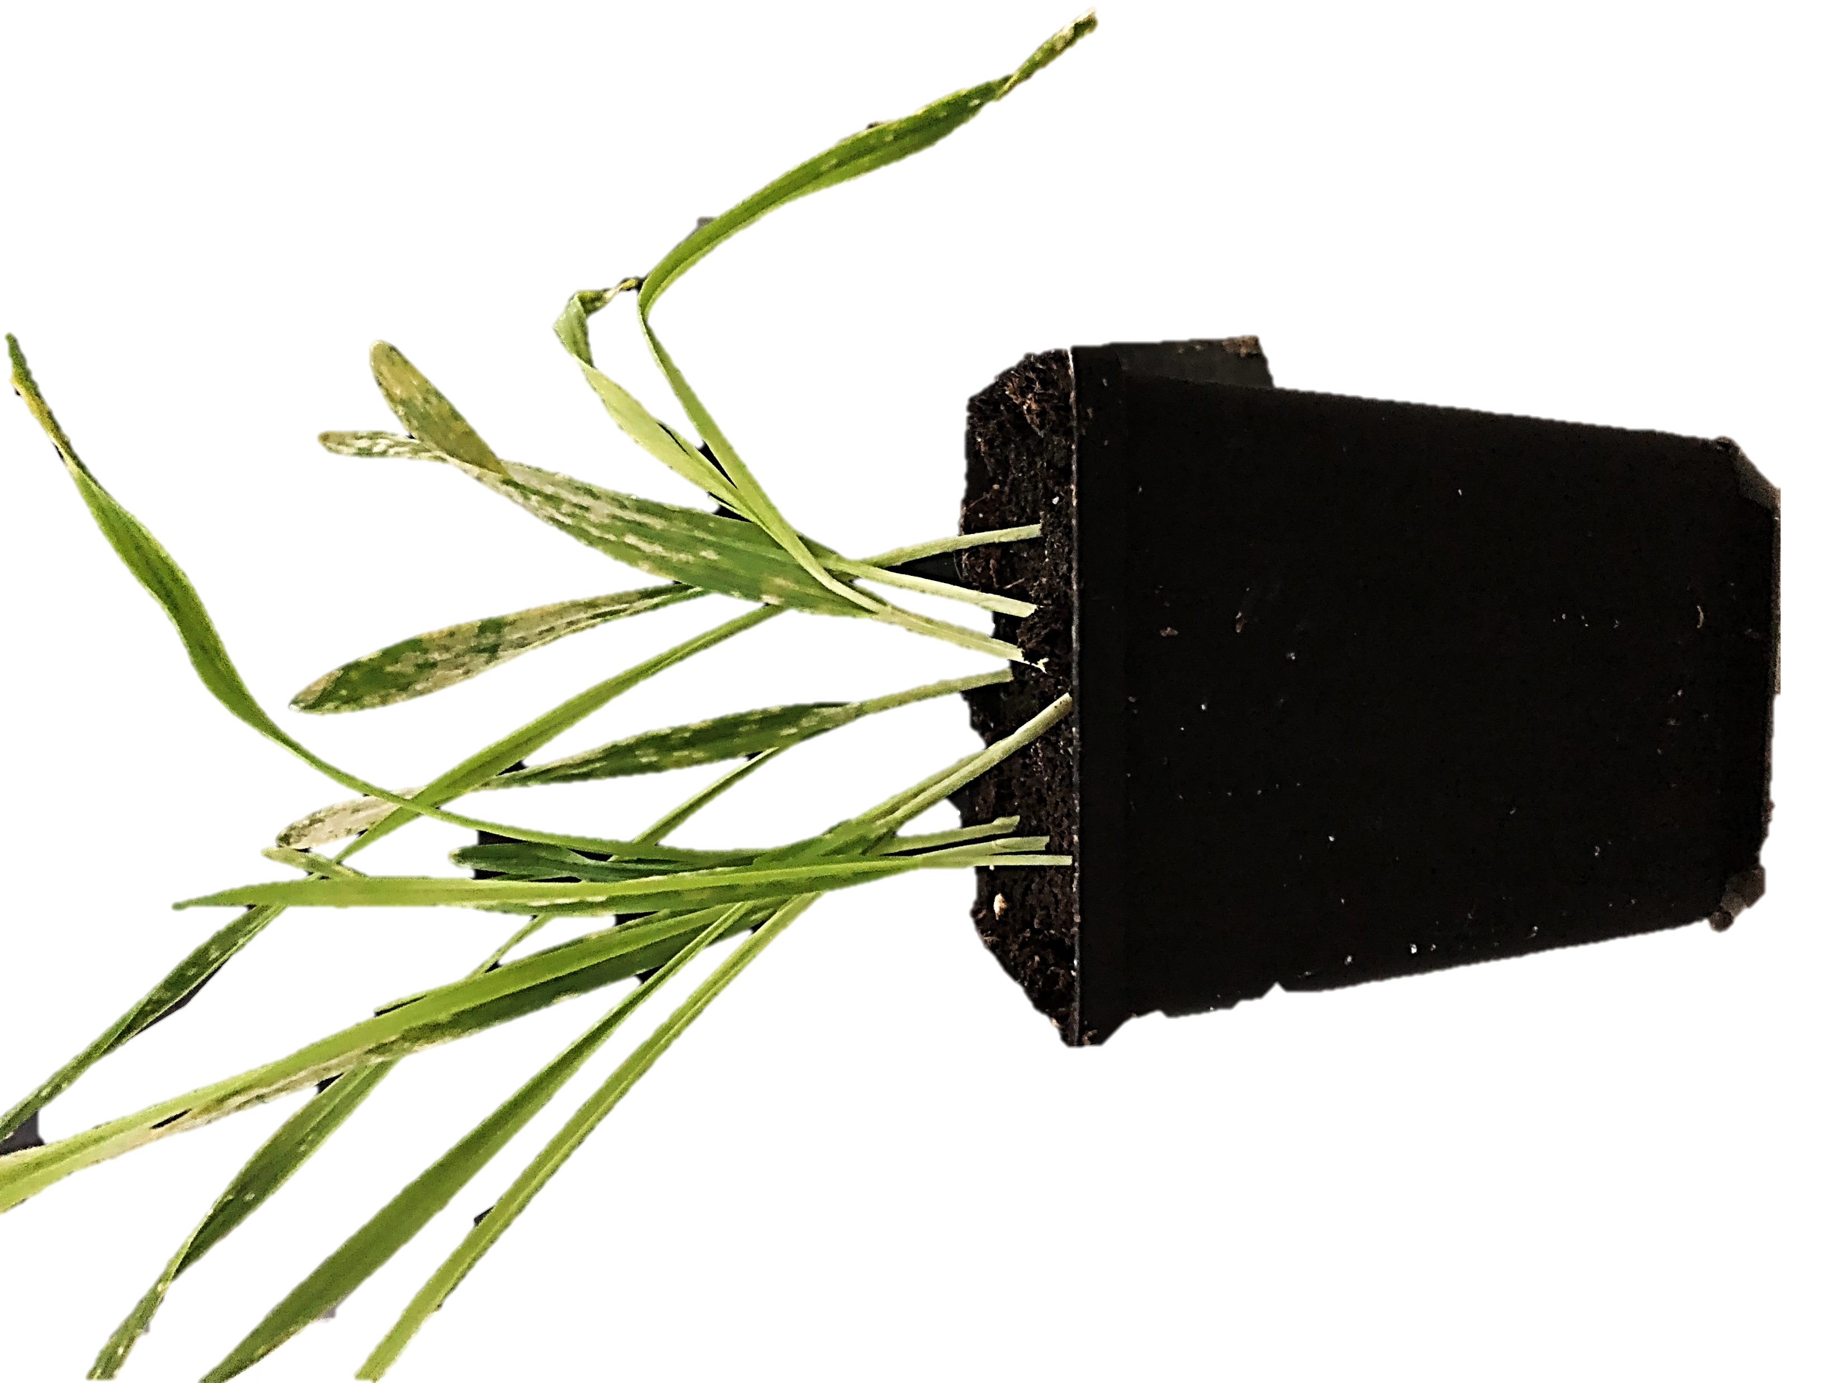

Slide 2
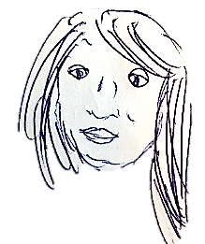
PhD Student
Bachelor/
Master
student
Team Leader
Research Assistent
PostDoc
You?
You?
Isabel
TBD
You?

